Slide 1
Design Pattern
Chain of Responsibility

Slide 2
Introduction
Category : Behavioral
Founder : Gang of Four

Slide 3
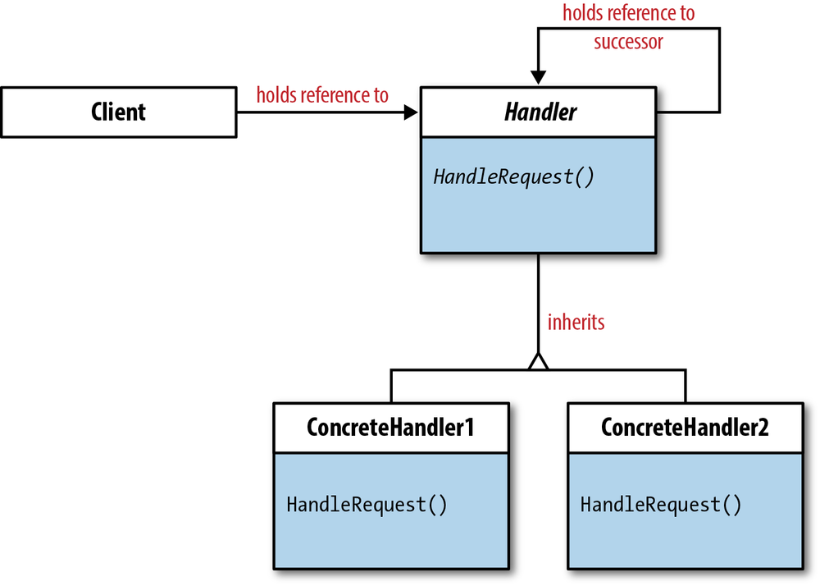
UML Diagram

Slide 4
Intent
Avoid coupling the sender of a request to its receiver by giving more than one object a chance to handle the request.
Chain the receiving objects and pass the request along the chain until an object handles it.
Launch-and-leave requests with a single processing pipeline that contains many possible handlers.
An object-oriented linked list with recursive traversal.

Slide 5
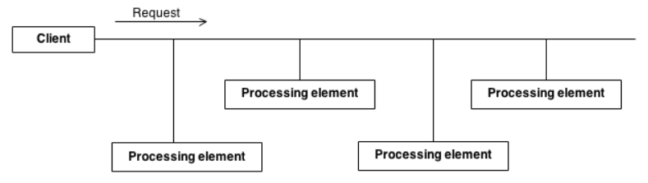
Problem
There is a potentially variable number of "handler" or "processing element" or "node" objects, and a stream of requests that must be handled.
Need to efficiently process the requests without hard-wiring handler relationships and precedence, or request-to-handler mappings.

Slide 6
Solution
Encapsulate the processing elements inside a "pipeline" abstraction; and have clients "launch and leave" their requests at the entrance to the pipeline.
The pattern chains the receiving objects together, and then passes any request messages from object to object until it reaches an object capable of handling the message. The number and type of handler objects isn't known a priori, they can be configured dynamically.
The chaining mechanism uses recursive composition to allow an unlimited number of handlers to be linked.
Chain of Responsibility simplifies object interconnections. Instead of senders and receivers maintaining references to all candidate receivers, each sender keeps a single reference to the head of the chain, and each receiver keeps a single reference to its immediate successor in the chain.
Make sure there exists a "safety net" to "catch" any requests which go unhandled.
Do not use Chain of Responsibility when each request is only handled by one handler, or, when the client object knows which service object should handle the request.

Slide 7
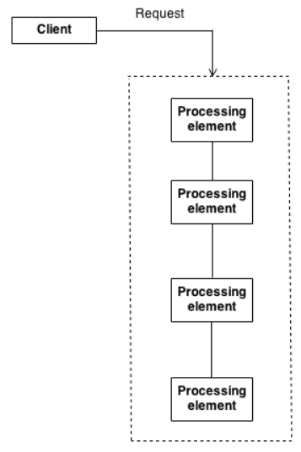

Slide 8
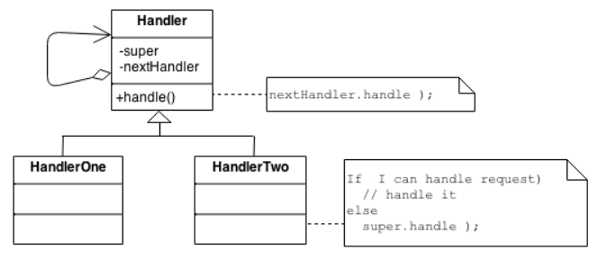
Architecture
The derived classes know how to satisfy Client requests. If the "current" object is not available or sufficient, then it delegates to the base class, which delegates to the "next" object, and the circle of life continues.
Multiple handlers could contribute to the handling of each request. The request can be passed down the entire length of the chain, with the last link being careful not to delegate to a "null next".

Slide 9
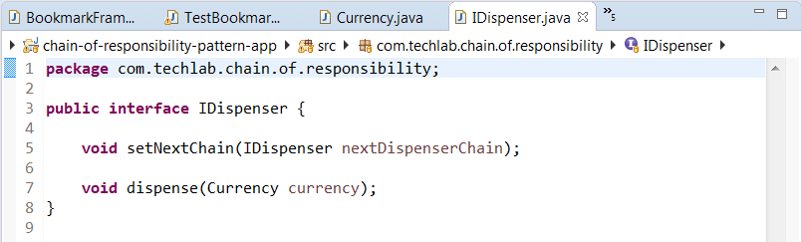
Code Snippet

Slide 10
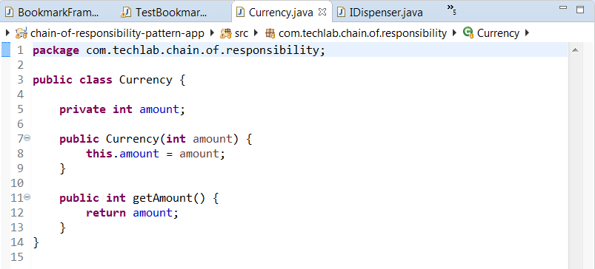
Code Snippet

Slide 11
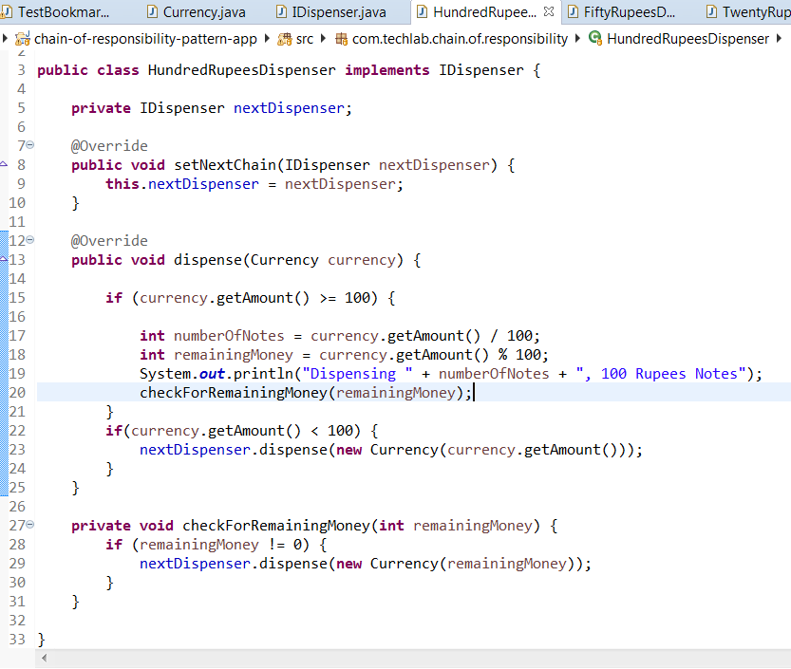
Code Snippet

Slide 12
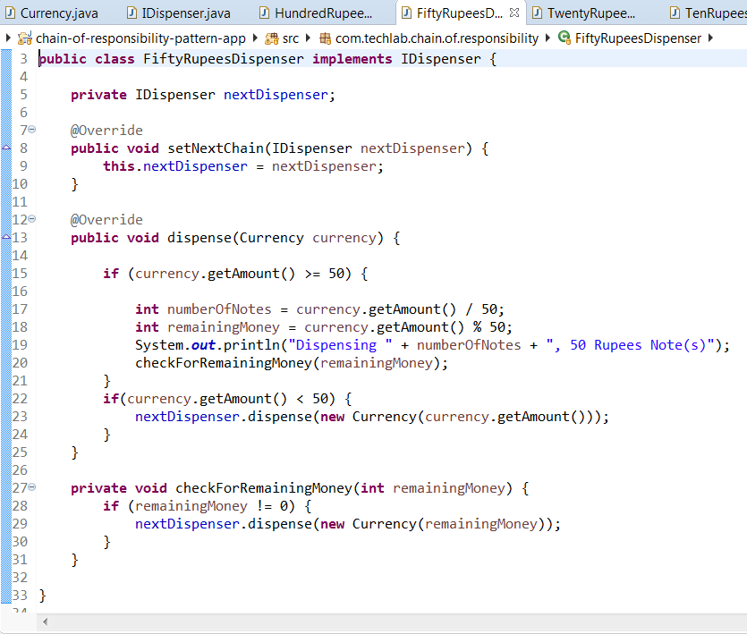
Code Snippet

Slide 13
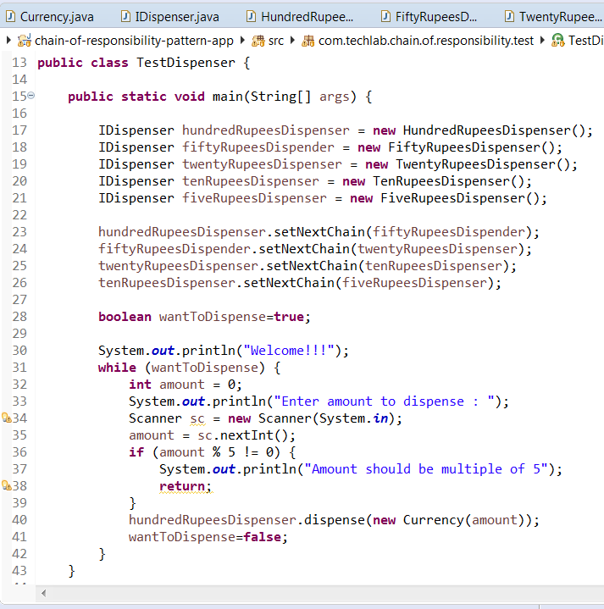
Code Snippet

Slide 14
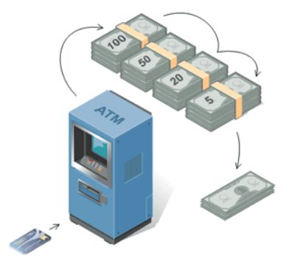
Real Life Example
ATM use the Chain of Responsibility in money giving mechanism.
User enters the amount to be retrieved and the ATM dispense amount in terms of defined currency bills such as 100 Rs, 50 Rs, 20 Rs, 5 Rs, etc.

Slide 15
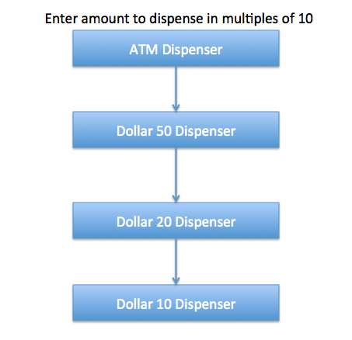

Slide 16
Points to Remember
The base class maintains a "next" pointer.
Each derived class implements its contribution for handling the request.
If the request needs to be "passed on", then the derived class "calls back" to the base class, which delegates to the "next" pointer.
The client (or some third party) creates and links the chain (which may include a link from the last node to the root node).
The client "launches and leaves" each request with the root of the chain.
Recursive delegation produces the illusion of magic.

